Slide 1


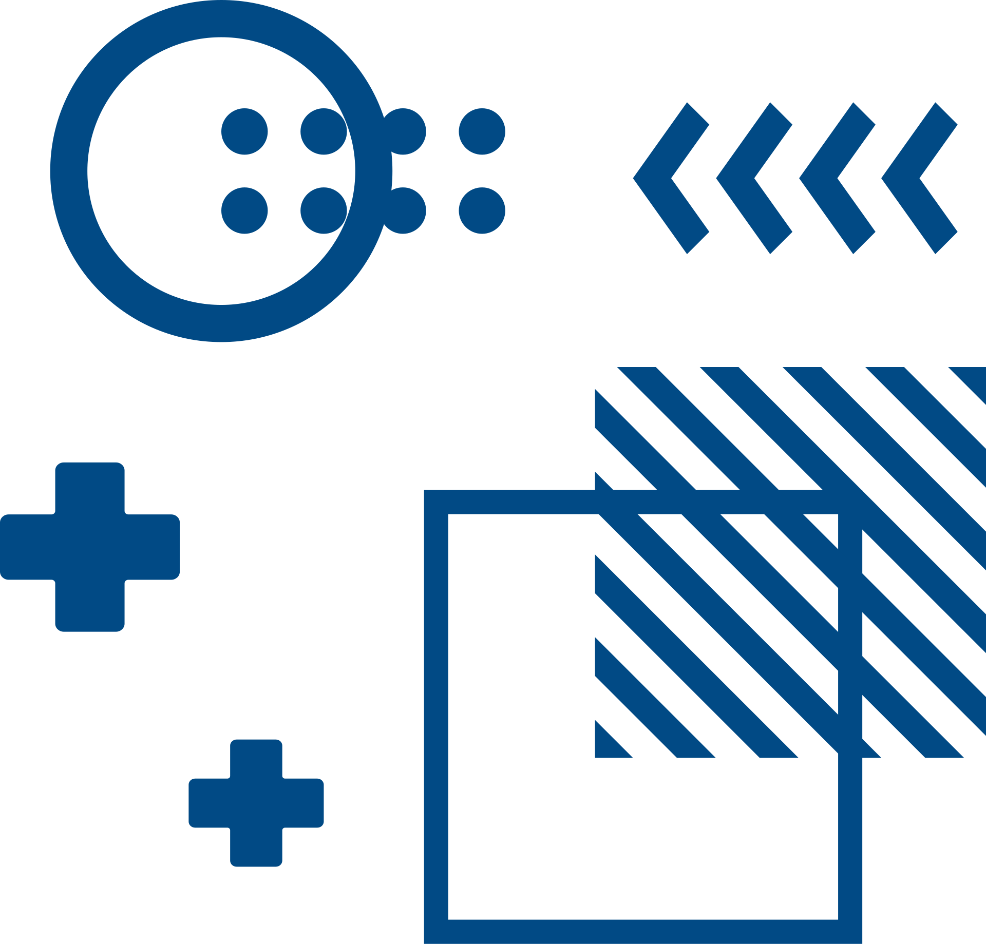

O’Haire lab
When is the best time for recruitment reach out
Presented by
Chi Thieu

Slide 2
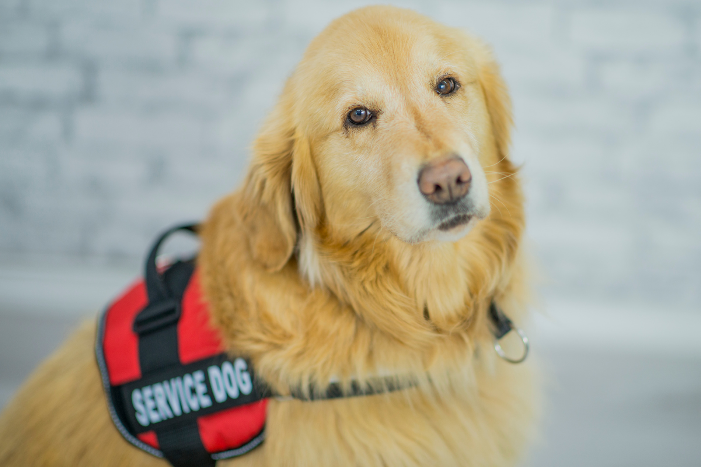
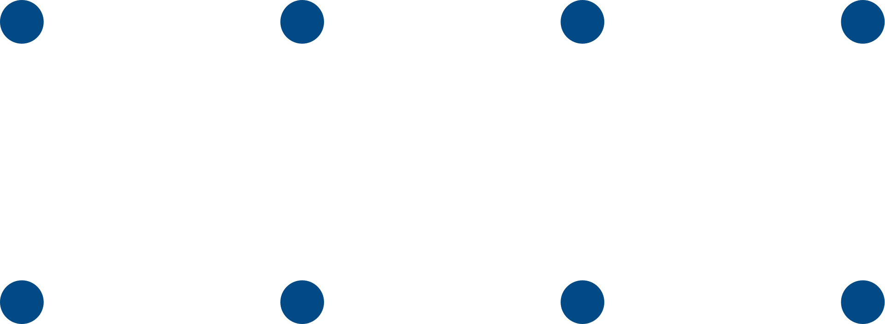
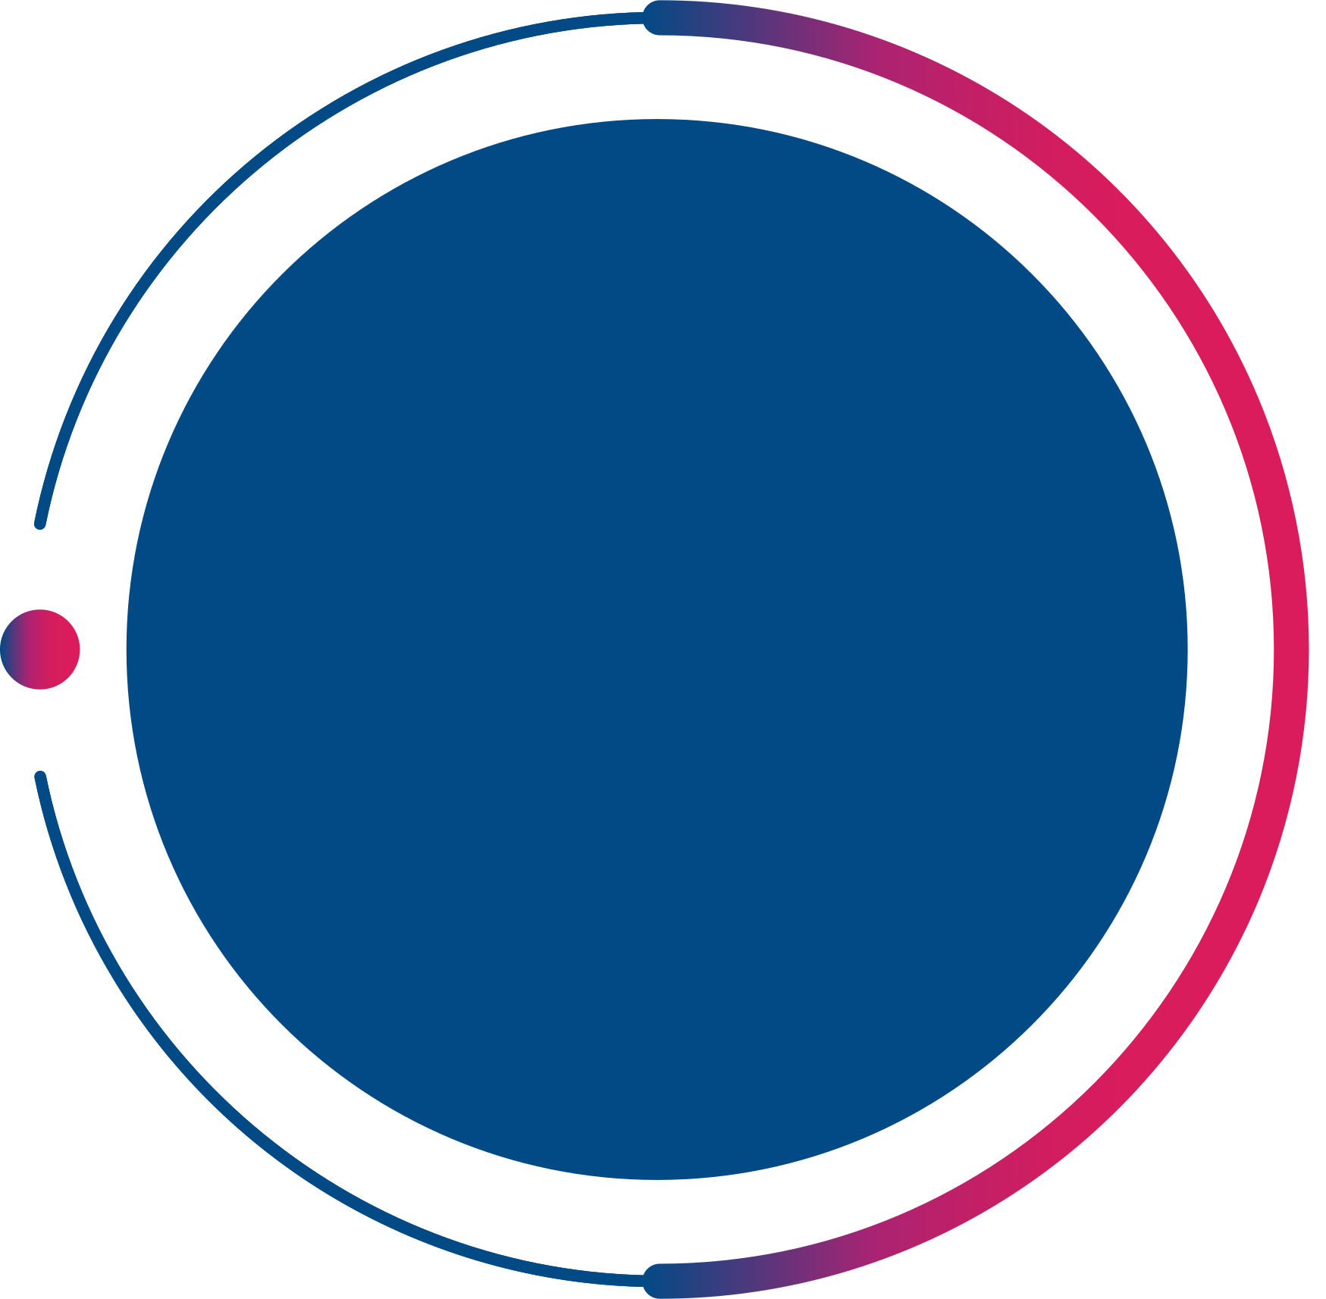

~54%
Overview
of recruited reach out moved to the study for recruitment result
Database are export from RedCap
Instrument include :
Welcome Packet
Recruitment Call
Additional Communication
Recruitment Result
For this project, 3 main focused field are welcome_date, recruitment call text_date, email_date and contact us to marked with participants willingness to moved to study arm or refused to move on. Assume all participants give final decision on the last reach out, average gap between first welcome packet sent date and final reach out day.
welcome date
recruitment Call
additional reach out

Slide 3

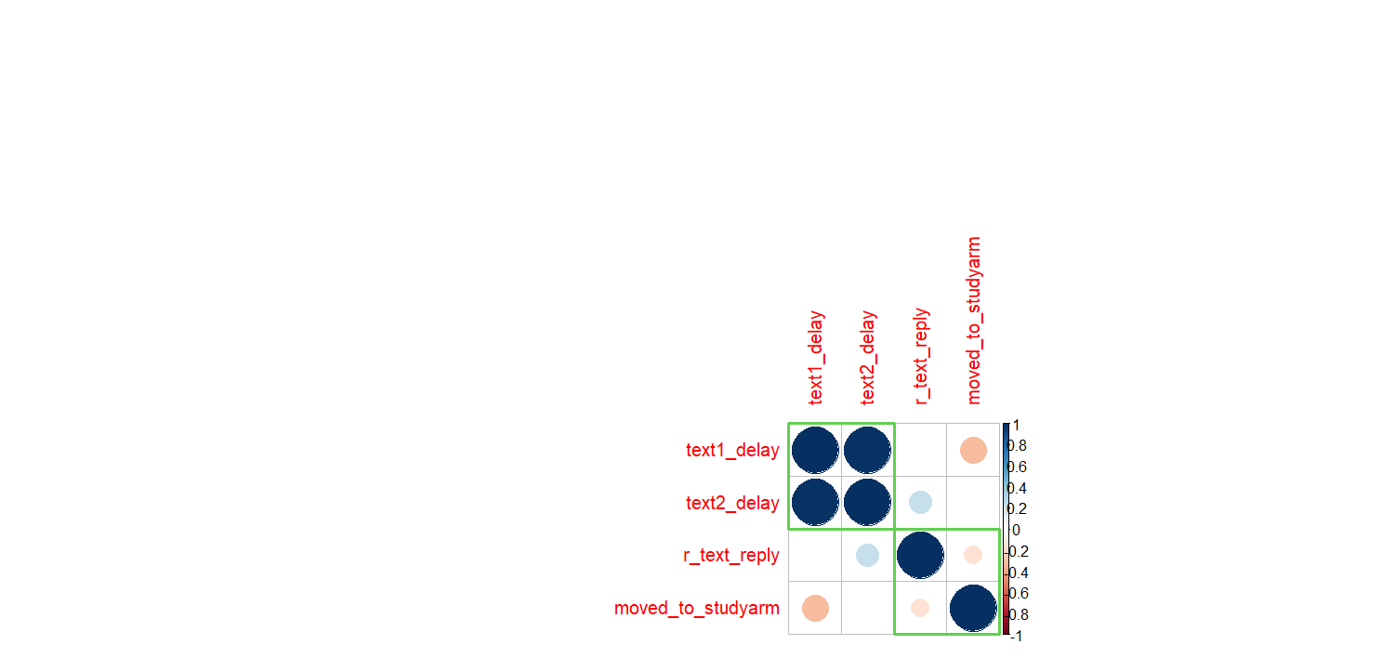
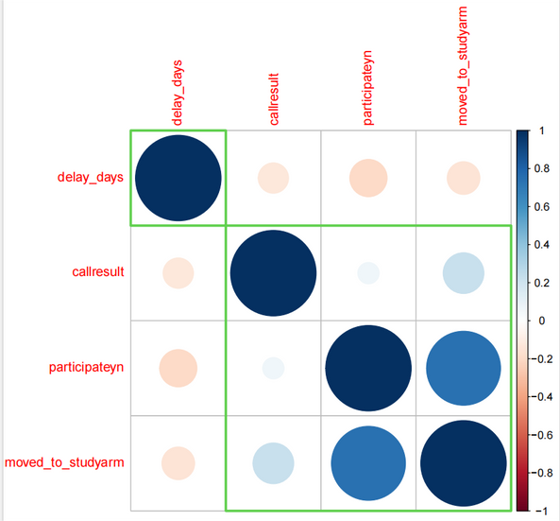
Main
Recruitment call
Finding
If the partcipants interested in joining during the recruitment, they are most likely will move o with the study
callresult and delay_days has negative impact on each other, which means if the delay_days increase, the partcipants might be unreachble.
Similar to it, the increase of delay_day also has lower rate of move on to study decision
The total of recruitment result : 357
no welcoming packet and recruitment call: 30
Other: 331
Extra communication
Since moved_to_studyarm represents whether someone moved into a study arm (1 = yes, 0 = no), the weak negative correlation with delay variables suggests that individuals who move into a study arm tend to experience slightly shorter delays in text responses. However, since the correlation is weak, the effect isn't strong or definitive.

Slide 4
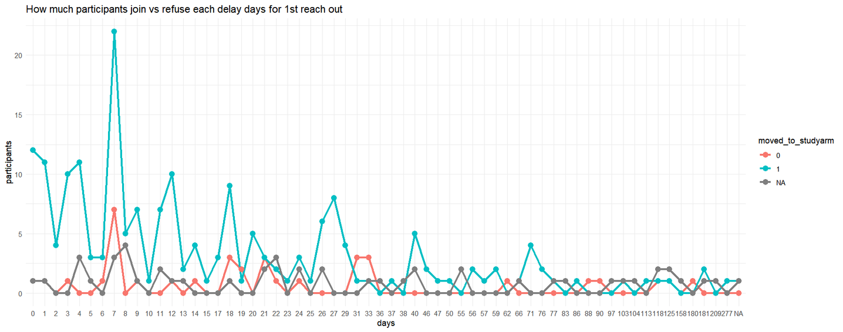
1st reach out rate for call recruitment
Hanover
and Tyke
Most participants who joined the study were contacted within the first 10 days, especially on Day 7, which shows a sharp peak with over 22 participants joining
Engagement (both joining and refusal) drops significantly after the first 30 days.
Beyond 30 days, participant responses become sparse and sporadic, with most days showing ≤2 interactions

Slide 5
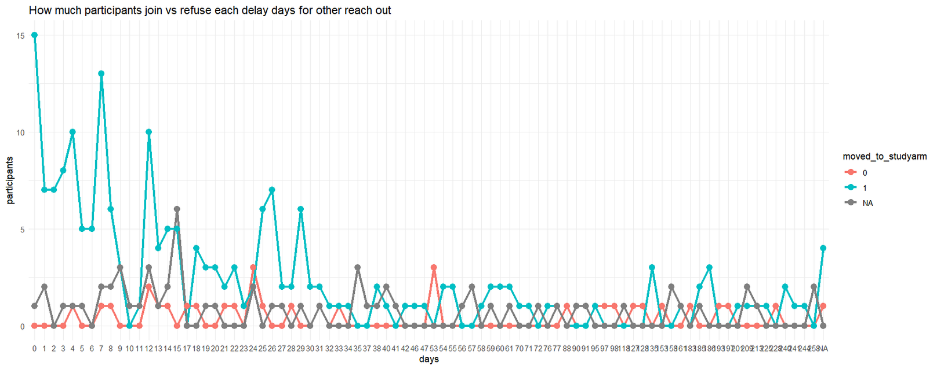
follow-up
recruitment call
The first 10 days see the highest number of participants joining, with Day 0 peaking at 15 joins

Slide 6


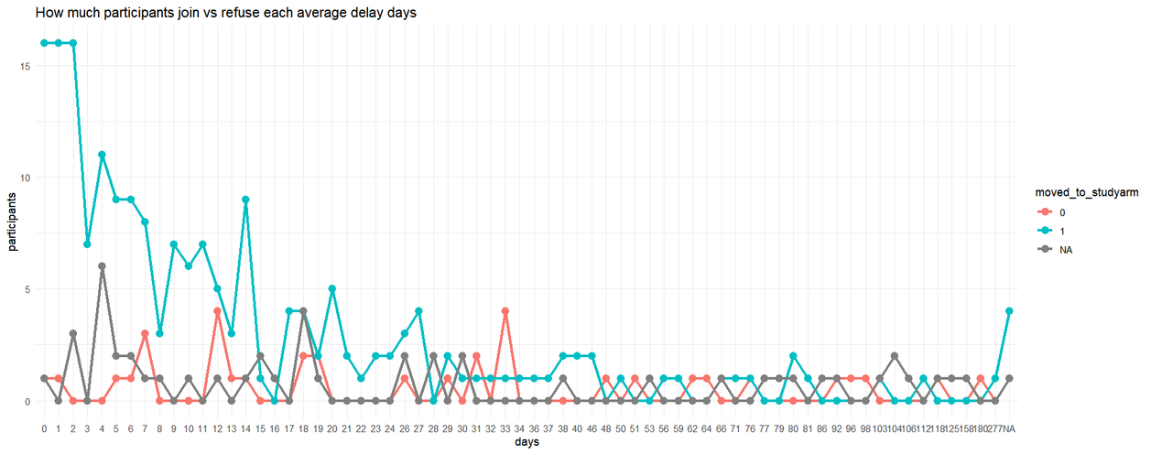
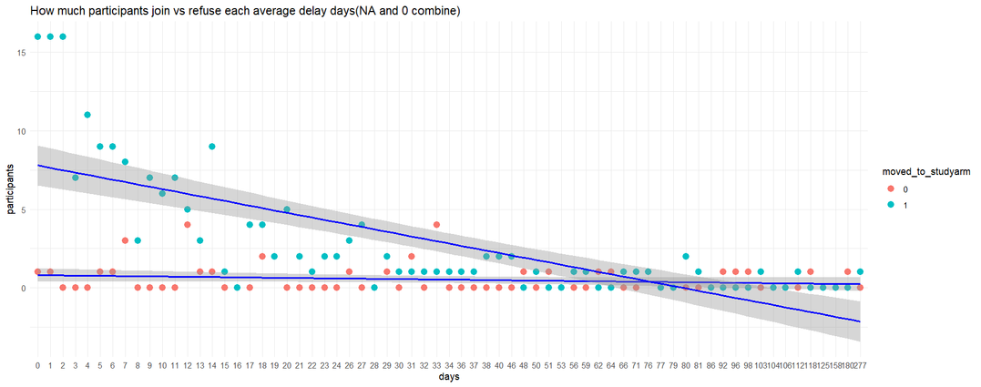
Participants
join and refuse rate for average delay day
Participants are more likely to join when contacted sooner
The highest join counts (~15–17 participants) are clustered between Days 0–7, reinforcing that rapid follow-up drives better recruitment outcomes.
The red trend line representing refusals is nearly flat, indicating the likelihood of refusal doesn’t significantly change with delay.
NA Outcomes Are Consistently Low

Slide 7


Thank you
for your attention

